Slide 1
CSE 6412: COMPUTATIONAL PROTEOMICS
CSE 6406: BIOINFORMATICS ALGORITHMS
CSE 463: INTRODUCTION TO BIOINFORMATICS
CSE 495: BIOINFORMATICS
Hidden markov model (HMM)

Slide 2
Outline
Classifying the HIV phenotypes
The “Fair Bet Casino”
Hidden Markov Model
Decoding Algorithm
Forward-Backward Algorithm
Gene prediction with HMMs
Profile HMMs
HMM Parameter Estimation
Viterbi training
Baum-Welch algorithm
Taken mostly from Pevzner’s original slides

Slide 3
The ever illusive HIV vaccine!
Vaccines are made from viral surface proteins
HIV envelop protein
  Mutate fast
  Masked by glycosylation
    a post-translational modification that often makes these proteins invisible to the human immune system

Slide 4
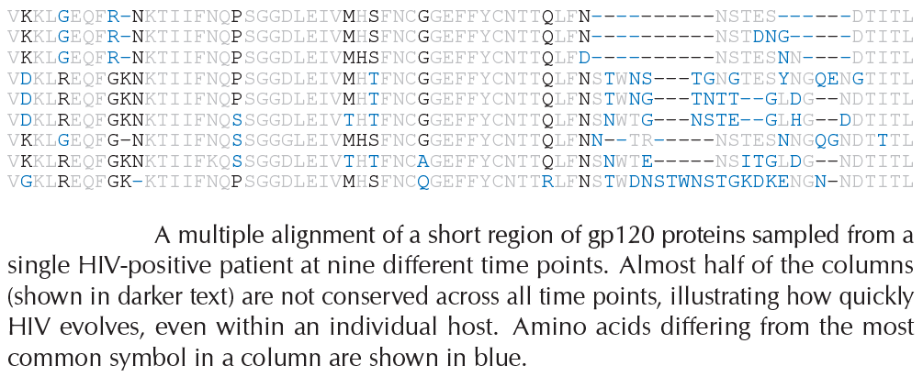
Fast mutating gp120 glycoprotein

Slide 5
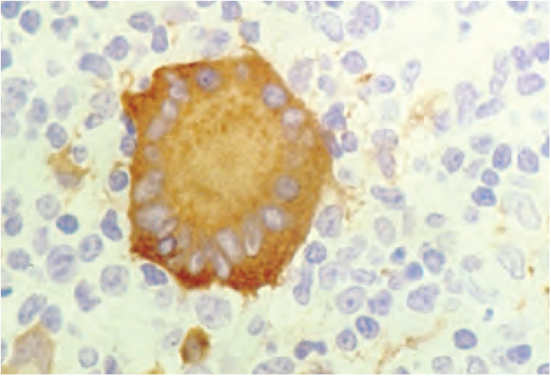
The SI and NSI isolates
HIV viruses can be divided into
  Fast-replicating syncytium-inducing (SI) isolates
  Slow-replicating non-syncytiuminducing (NSI) isolates
During infection, gp120 proteins are transported to the cell surface
They can cause the host cell membrane to fuse with neighboring cells.
This causes dozens of human cells to fuse their cell membranes into a giant, nonfunctional syncytium, or abnormal multinucleate cell.
This mechanism allows an SI virus to kill many human cells by infecting only one.

Slide 6
How to classify SI and NSI phenotypes?
Which amino acids in gp120 can be used in classifying a virus as SI or NSI?
  Multiple sequence alignment
  Difficult algorithmic problem for highly diverged sequences
  Why should the same scoring matrix be used in each column?
  A better approach would use a different scoring approach at different columns.

Slide 7
CG-Islands
Given 4 nucleotides: probability of occurrence is ~ 1/4. Thus, probability of occurrence of a dinucleotide is ~ 1/16.
However, the frequencies of dinucleotides in DNA sequences vary widely.
In particular, CG is typically underepresented (frequency of CG is typically < 1/16)

Slide 8
Why CG-Islands?
CG is the least frequent dinucleotide because C in CG is easily methylated and has the tendency to mutate into T afterwards
However, the methylation is suppressed around genes in a genome. So, CG appears at relatively high frequency within these CG islands
So, finding the CG islands in a genome is an important problem

Slide 9
CG Islands and the “Fair Bet Casino”
The CG islands problem can be modeled after a problem named “The Fair Bet Casino”
The game is to flip coins, which results in only two possible outcomes: Head or Tail.
The Fair coin will give Heads and Tails with same probability ½.
The Biased coin will give Heads with prob. ¾.

Slide 10
The “Fair Bet Casino” (cont’d)
Thus, we define the probabilities:
  P(H|F) = P(T|F) = ½
  P(H|B) = ¾, P(T|B) = ¼
  The crooked dealer chages between Fair and Biased coins with probability 10%

Slide 11
The Fair Bet Casino Problem
Input: A sequence x = x₁x₂x₃…x_{n} of coin tosses made by two possible coins (F or B).
Output: A sequence π = π₁ π₂ π₃… π_{n}, with each π_{i} being either F or B indicating that x_{i} is the result of tossing the Fair or Biased coin respectively.

Slide 12
Problem…
Fair Bet Casino Problem
Any observed outcome of coin tosses could have been generated by any sequence of states!
Need to incorporate a way to grade different sequences differently.
Decoding Problem

Slide 13
P(x|fair coin) vs. P(x|biased coin)
Suppose first that dealer never changes coins. Some definitions:
  P(x|fair coin): prob. of the dealer using
  the F coin and generating the outcome x.
  P(x|biased coin): prob. of the dealer using the B coin and generating outcome x.
  We will assume that this biased coin results in heads with probability 3/4

Slide 14
P(x|fair coin) vs. P(x|biased coin)
P(x|fair coin)=P(x₁…x_{n}|fair coin)
Π_{i=1,n} p (x_{i}|fair coin)= (1/2)^{n}
P(x|biased coin)= P(x₁…x_{n}|biased coin)=
Π_{i=1,n} p (x_{i}|biased coin)=(3/4)^{k}(1/4)^{n-k}= 3^{k}/4^{n}
  k - the number of Heads in x.

Slide 15
P(x|fair coin) vs. P(x|biased coin)
P(x|fair coin) = P(x|biased coin)
1/2^{n} = 3^{k}/4^{n}
2^{n} = 3^{k}
n = k log₂3
when k = n / log₂3 (k ~ 0.63n)
If we witness less than 63 heads (k) in n = 100 flips, the log-odds then more likely that fair coin is used.

Slide 16
Log-odds Ratio
We define log-odds ratio as follows:
log₂(P(x|fair coin) / P(x|biased coin))
= Σ^{k}_{i=1} log₂(p⁺(x_{i}) / p⁻(x_{i}))
= n – k log₂3

Slide 17
Computing Log-odds Ratio in Sliding Windows
x₁x₂x₃x₄x₅x₆x₇x₈…x_{n}
Consider a sliding window of the outcome sequence. Find the log-odds for this short window.
0
Log-odds value
Biased coin most likely used
Fair coin most likely used
Disadvantages:
- different windows may classify the same position differently

Slide 18
Hidden Markov Model (HMM)
Can be viewed as an abstract machine with k hidden states that emits symbols from an alphabet Σ.
Each state has its own probability distribution, and the machine switches between states according to this probability distribution.
While in a certain state, the machine makes 2 decisions:
  What state should I move to next?
  What symbol - from the alphabet Σ - should I emit?

Slide 19
Why “Hidden”?
Observers can see the emitted symbols of an HMM but have no ability to know which state the HMM is currently in.
Thus, the goal is to infer the most likely hidden states of an HMM based on the given sequence of emitted symbols.

Slide 20
HMM Parameters
Σ: set of emission characters.
Ex.: Σ = {H, T} for coin tossing
Σ = {1, 2, 3, 4, 5, 6} for dice tossing
Q: set of hidden states, each emitting symbols from Σ.
Q={F,B} for coin tossing

Slide 21
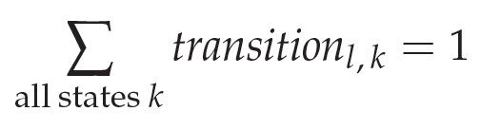
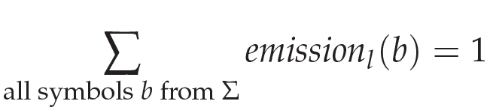
HMM Parameters (cont’d)
A = (a_{kl}): a |Q| x |Q| matrix of probability of changing from state k to state l.
a_{FF} = 0.9 a_{FB} = 0.1
a_{BF} = 0.1 a_{BB} = 0.9
E = (e_{k}(b)): a |Q| x |Σ| matrix of probability of emitting symbol b while being in state k.
e_{F}(0) = ½ e_{F}(1) = ½
e_{B}(0) = ¼ e_{B}(1) = ¾

Slide 22
HMM for Fair Bet Casino
The Fair Bet Casino in HMM terms:
Σ = {0, 1} (0 for Tails and 1 Heads)
Q = {F,B} – F for Fair & B for Biased coin.
Transition Probabilities A *** Emission Probabilities E
 | Fair | Biased
Fair | a_{FF} = 0.9 | a_{FB} = 0.1
Biased | a_{BF} = 0.1 | a_{BB} = 0.9
 | Tails(0) | Heads(1)
Fair | e_{F}(0) = ½ | e_{F}(1) = ½
Biased | e_{B}(0) = ¼ | e_{B}(1) = ¾

Slide 23
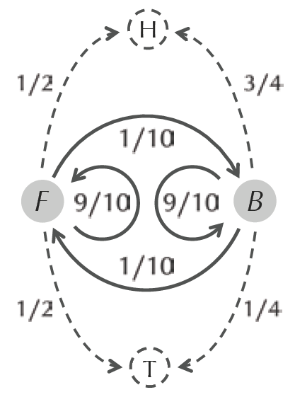
HMM for Fair Bet Casino (cont’d)
HMM model for the Fair Bet Casino Problem

Slide 24
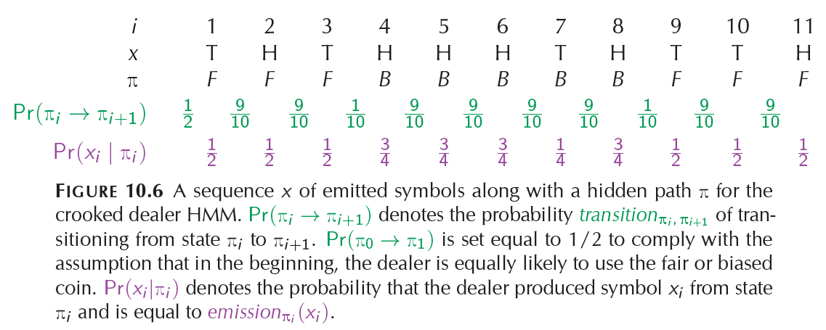
Hidden Paths
Π₀ is a “silent” initial state that does not emit any symbols

Slide 25

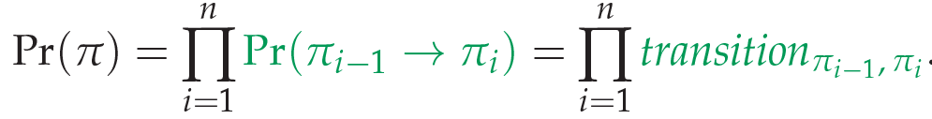
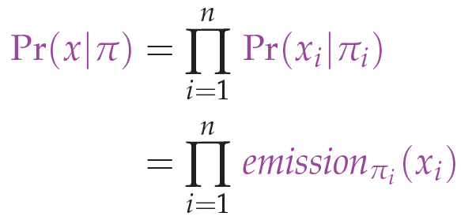
Probability Calculations

Slide 26
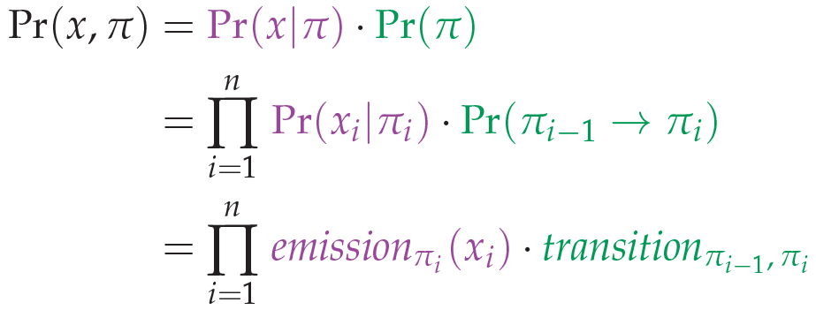
Probability Calculations

Slide 27
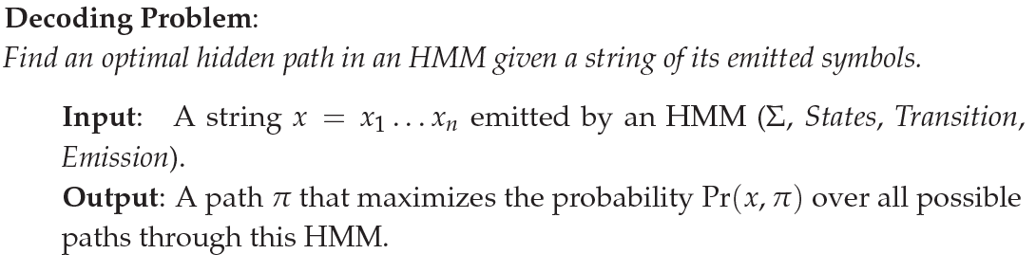
Decoding Problem
Andrew Viterbi used the Manhattan grid model to solve Decoding Problem
Every choice of π = π₁… π_{n} corresponds to a path in the graph.
The only valid direction in the graph is eastward.
This graph has |Q |²(n-1) edges.
Augmenting with a source and sink node adds 2|Q| extra edges.

Slide 28
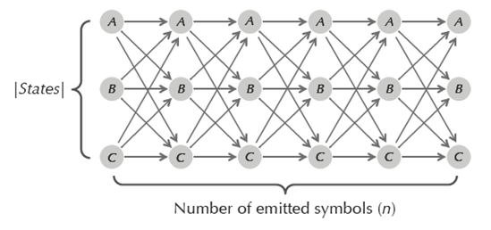
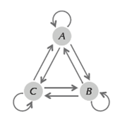
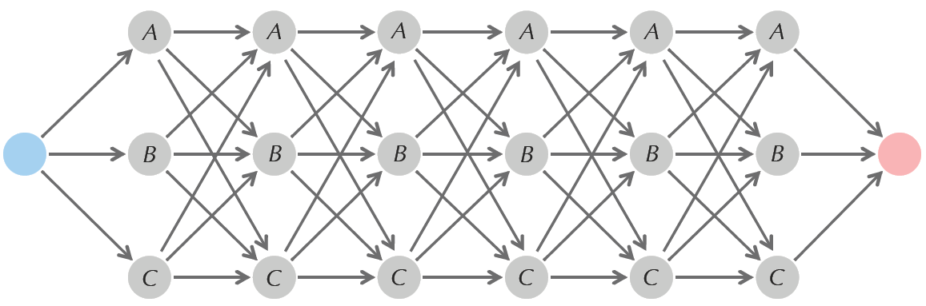
Viterbi Graph
State transition diagram
Viterbi’s Manhattan
The Viterbi graph with additional source node (blue) and sink node (red)
Notes:
Given a string of n symbols x = x_{1,} x₂. . . x_{n} emitted by an HMM, Viterbi’s Manhattan is a grid with |States| rows and n columns in which each node is connected to every node in the column to its right.
The weight of the edge connecting (l, i − 1) to (k, i) is WEIGHT_{i}(l, k) = transition_{l, k} x emission_{k}(x_{i})
A path of largest product weight connecting the source to the sink corresponds to an optimal hidden path solving the Decoding Problem.

Slide 29
Decoding Problem as Finding a Longest Path in a DAG
The Decoding Problem is reduced to finding a longest path in the directed acyclic graph (DAG) above.
Notes: the length of the path is defined as the product of its edges’ weights, not the sum.

Slide 30
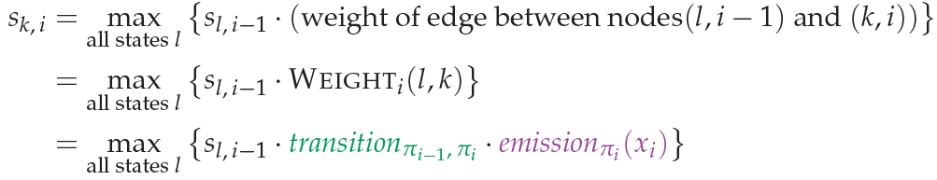

Viterbi Algorithm
Initialization: Set s_{source} equal to 1

Slide 31



Viterbi Algorithm
Find a path Π that maximizes the product weight
The value of the product can become extremely small, which leads to overflowing.
To avoid overflowing, use log value instead.
Running Time

Slide 32
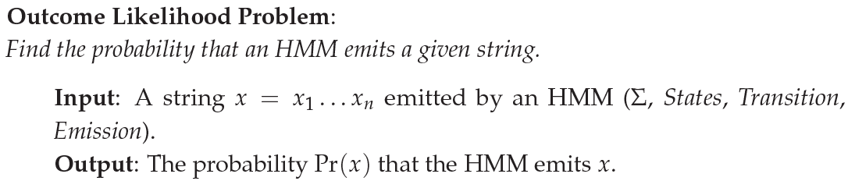
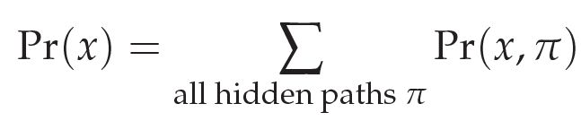
Outcome Likelihood
forward_{k, I} → Total product weight of all paths from source to node (k, i) in the Viterbi graph
forward_{sink} → Pr(x)

Slide 33
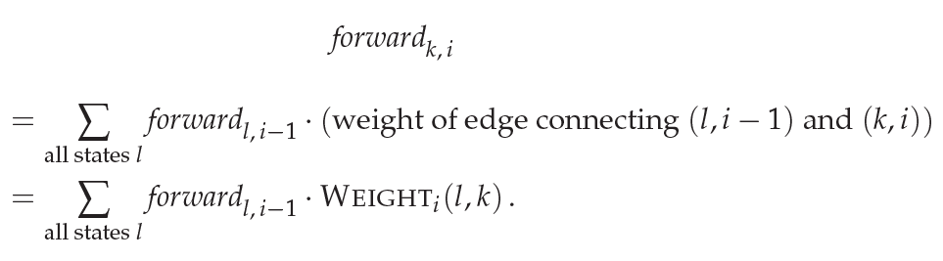
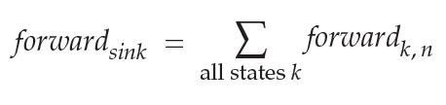
Outcome Likelihood (Forward Algorithm)
Recall that
WEIGHT_{i}(l, k) = transition_{l, k} x emission_{k}(x_{i})
Finally

Slide 34
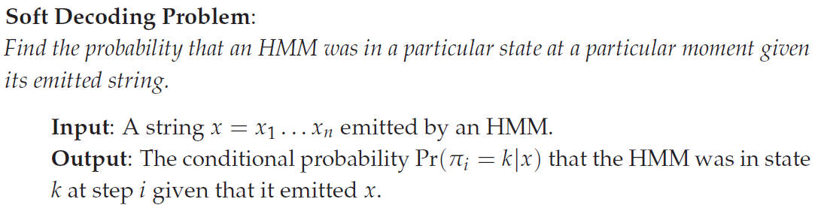

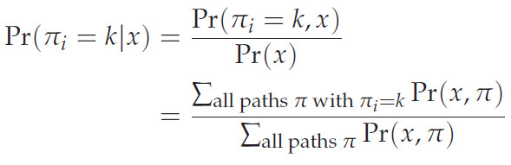
The Soft Decoding Problem
Notes:
Say that the i-th coin flip is heads.
If this flip occurs in the middle of ten consecutive heads, then you should be relatively confident that the biased coin was used.
But what if, of the ten flips surrounding the i-th flip, six are heads and four are tails? In this case, you should be less certain that the biased coin was used.
2. In the case of an arbitrary HMM, we would like to compute the conditional probability Pr(Π = k|x) that the HMM was in state k at time i given that it emitted string x.

Slide 35
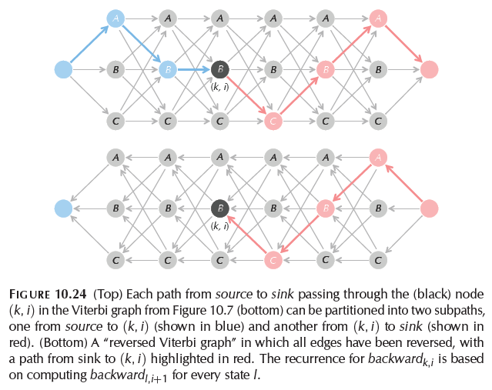
The forward-backward algorithm

Slide 36

Backward Algorithm (cont’d)
backward_{k,i} → Probability of emitting the suffix x_{i+1}…x_{n} given the HMM is in state π_{i} = k
The recurrence for the backward algorithm:
Recall that
WEIGHT_{i}(l, k) = transition_{l, k} x emission_{k}(x_{i})

Slide 37
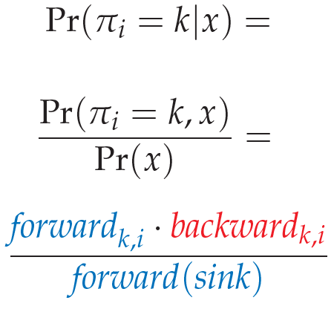
The forward-backward algorithm

Slide 38
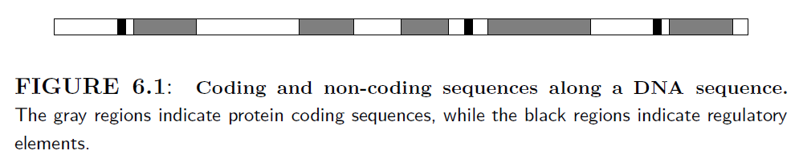
Gene prediction
START codon (AUG)
STOP codon (UAA, UAG, UGA)
Searching for START and STOP codon
  Not enough
  Pseudo genes
Notes:
Coding sequences. Codes for proteins.
Junk DNA. These parts do not code for protein, but much information is actually encoded in these regions, in the form of regulatory elements that control transcription, patterns that control DNA folding and many RNA molecules with various functions (including DNA replication and transcription, and protein translation).

Slide 39
Gene prediction
Random duplication events
  Copied partial segments of protein coding sequences to other locations along the genome.
  Many of them could not be transcribed or failed to fold into a functioning protein and were gradually degraded through random mutations.
  Pseudo-genes
Therefore, there are many start codons that are not followed by coding regions.

Slide 40
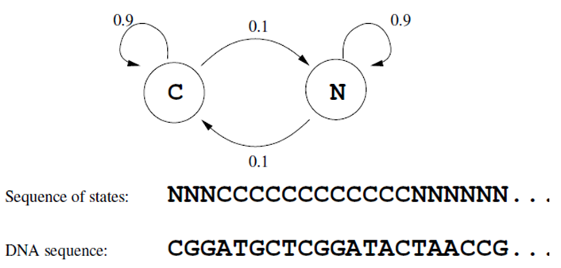
Gene prediction (MM)
Coding sequences are compiled of codons, thus having certain structural constraints.
Thus, it is expected that the statistics of nucleotides would be different in coding vs. non-coding regions.
Notes:
A two-state Markov model. This simple model has only two states,
Coding (C) and
Non-coding (N).
A sequence of moves through the model generates a sequence of states, each one corresponds to one position along the DNA sequence.
This model, however, ignores the statistics of nucleotides within coding and non-coding sequences

Slide 41
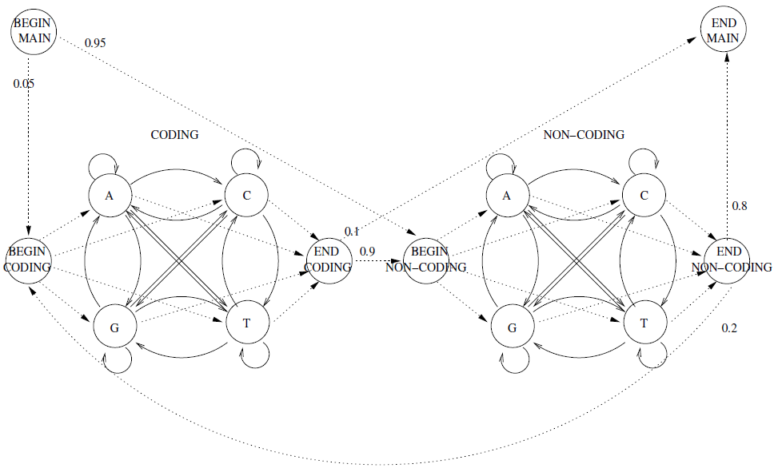
Gene prediction (MM)

Slide 42
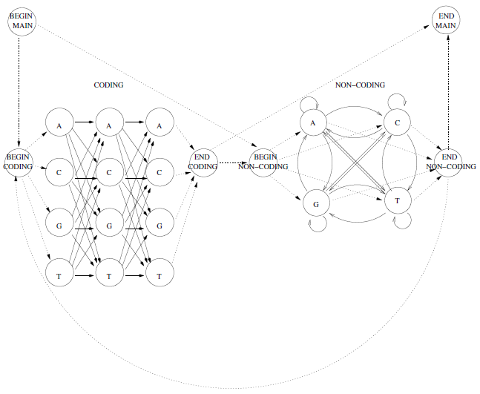
Gene prediction (MM)
Notes:
Takes care of codon structure.
The transition probabilities can be estimated from a training dataset, where the locations of the coding regions are marked
[MDSR] – I think outgoing edges should be there from layer 3 back to layer 1. (i.e. beginning of a new codon)

Slide 43
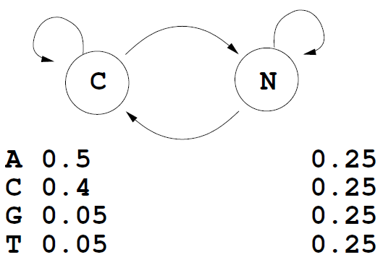
Gene prediction (HMM)
Notes:
The model has only two states, coding (C) and non-coding (N).
Each state can emit any of the four nucleotides with different probabilities. For example, the probability to emit A in the coding state is 0.5.

Slide 44
Gene prediction (HMM)
A better model would account for
  Codon structure
  Unique signals (i.e., promoters) preceding the coding regions
  Splice sites inside the coding regions

Slide 45
Finding Distant Members of a Protein Family
A distant cousin of functionally related sequences in a protein family may have weak pairwise similarities with each member of the family and thus fail significance test.
However, they may have weak similarities with many members of the family.
The goal is to align a sequence to all members of the family at once.
Family of related proteins can be represented by their multiple alignment and the corresponding profile.

Slide 46
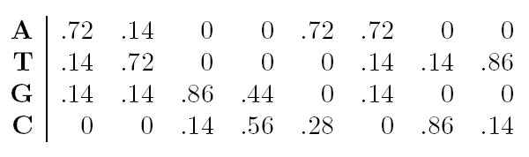
Profile Representation of Protein Families
Aligned DNA sequences can be represented by a
4 ·n profile matrix reflecting the frequencies
of nucleotides in every aligned position.
Protein family can be represented by a 20·n profile representing frequencies of amino acids.

Slide 47
Profiles and HMMs
HMMs can also be used for aligning a sequence against a profile representing
protein family.
A 20·n profile P corresponds to n sequentially linked match states M₁,…,M_{n} in the profile HMM of P.

Slide 48
Multiple Alignments and Protein Family Classification
Multiple alignment of a protein family shows variations in conservation along the length of a protein
Example: after aligning many globin proteins, the biologists recognized that the helices region in globins are more conserved than others.

Slide 49
What are Profile HMMs ?
A Profile HMM is a probabilistic representation of a multiple alignment.
A given multiple alignment (of a protein family) is used to build a profile HMM.
This model then may be used to find and score less obvious potential matches of new protein sequences.

Slide 50
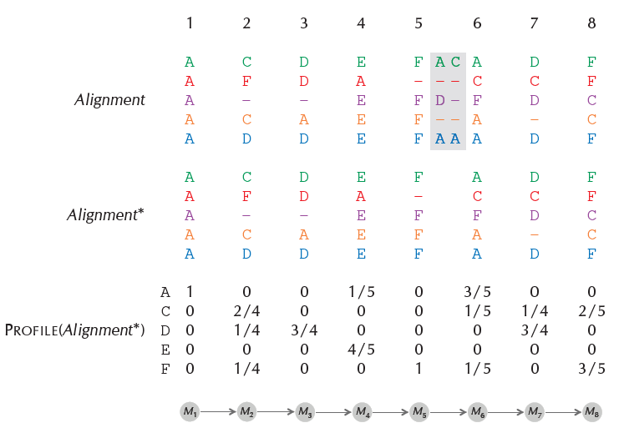

Slide 51
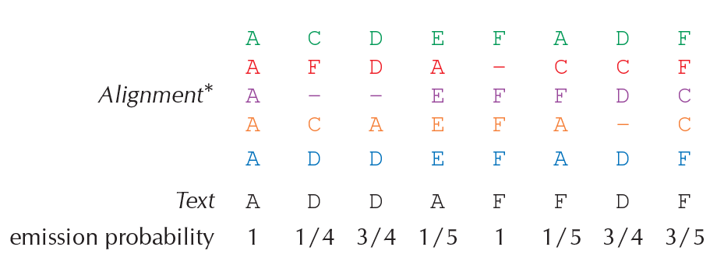

Slide 52
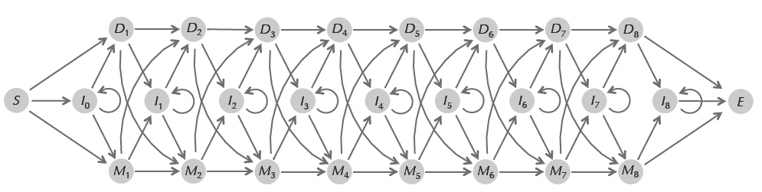
Profile HMM
A profile HMM

Slide 53
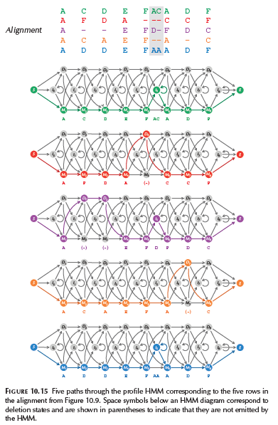
Calculating transition and emission probabilities

Slide 54
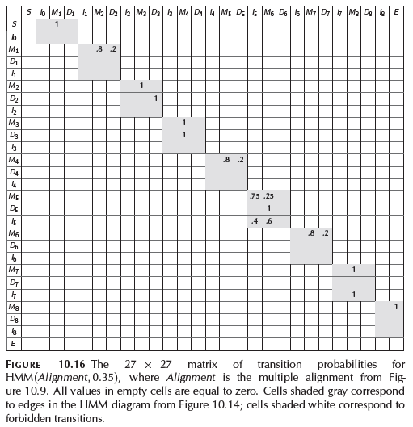
Transition Probabily Matrix

Slide 55
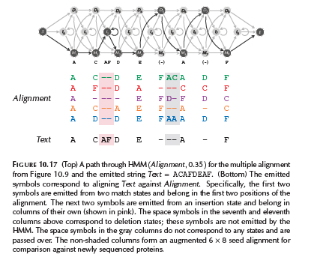
Fitting a query protein

Slide 56
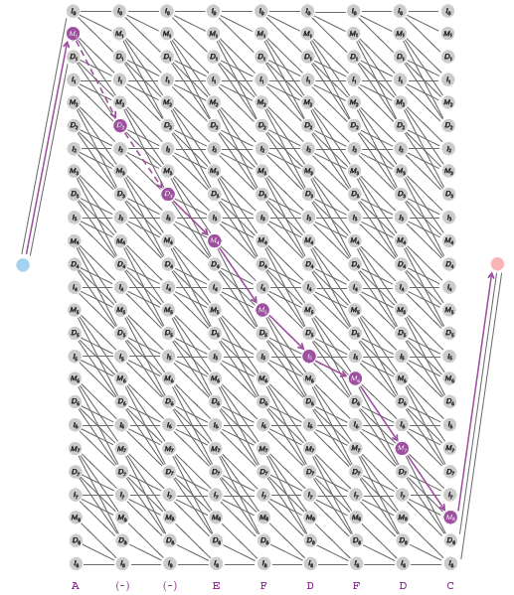
Viterbi Graph?

Slide 57
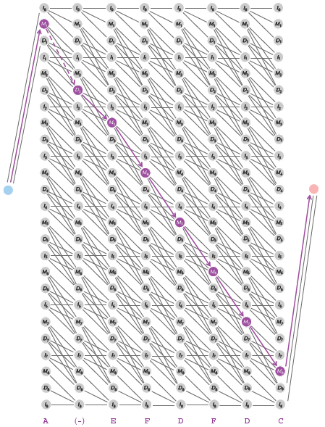
Viterbi Graph?

Slide 58
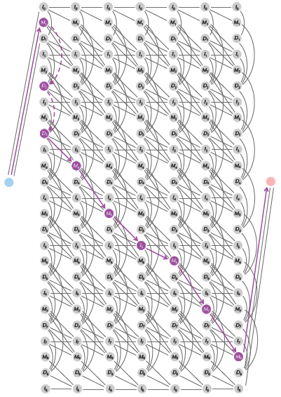
Viterbi Graph?

Slide 59
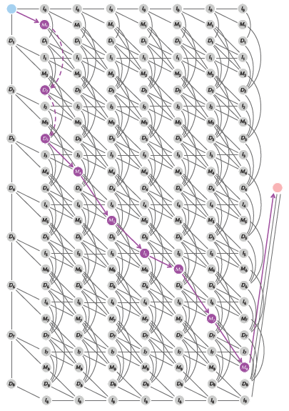
Viterbi Graph
Notes:
The Viterbi graph with |States| rows and |Text| columns for the profile HMM from Figure 10.14 emitting a string Text of length 7
Edges entering deletion states are drawn downward within the same column.
Edges between columns have a rightward orientation.

Slide 60
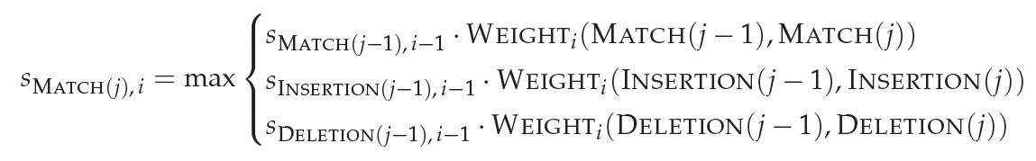
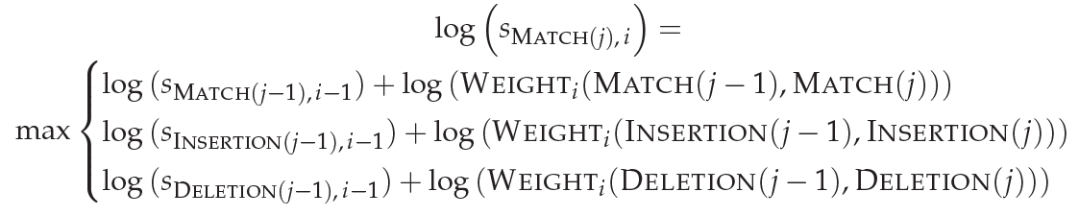

Slide 61
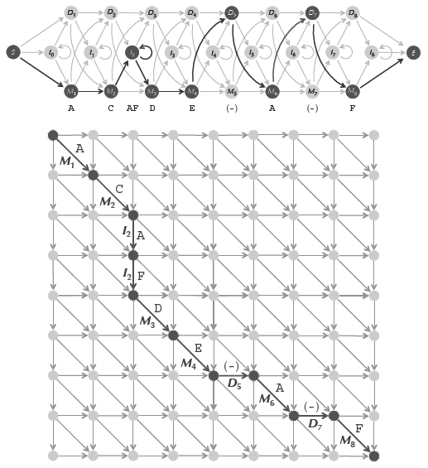
Paths in Edit Graph and Profile HMM

Slide 62
HMM Parameter Estimation
So far, we have assumed that the transition and emission probabilities are known.
However, in most HMM applications, the probabilities are not known. It’s very hard to estimate the probabilities.

Slide 63
HMM Parameter Estimation Problem
Given
HMM with states and alphabet (emission characters)
Independent training sequences x¹, … x^{m}
Find HMM parameters Θ (that is, a_{kl}, e_{k}(b)) that maximize
P(x¹, …, x^{m} | Θ)
the joint probability of the training sequences.

Slide 64
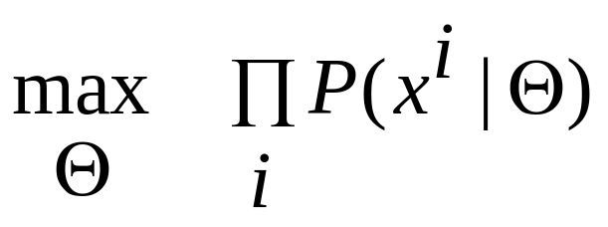
Maximize the likelihood
P(x¹, …, x^{m} | Θ) as a function of Θ is called the likelihood of the model.
The training sequences are assumed independent, therefore
P(x¹, …, x^{m} | Θ) = Π_{i} P(x^{i} | Θ)
The parameter estimation problem seeks Θ that realizes
In practice the log likelihood is computed to avoid underflow errors

Slide 65

Two situations
Known paths for training sequences
One evening the casino dealer allows us to see when he changes dice
Unknown paths
Do not see when the casino dealer changes dice

Slide 66
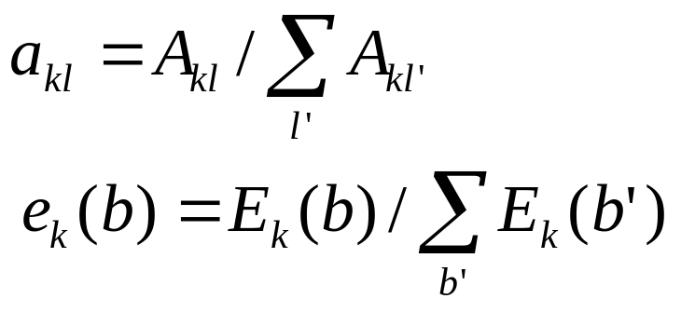
Known paths
A_{kl} = # of times each k → l is taken in the training sequences
E_{k}(b) = # of times b is emitted from state k in the training sequences
Compute a_{kl} and e_{k}(b) as maximum likelihood estimators:

Slide 67
Pseudocounts
Some state k may not appear in any of the training sequences. This means A_{kl} = 0 for every state l and a_{kl} cannot be computed with the given equation.
To avoid this overfitting use predetermined pseudocounts r_{kl} and r_{k}(b).
A_{kl} = # of transitions k→l + r_{kl}
E_{k}(b) = # of emissions of b from k + r_{k}(b)
The pseudocounts reflect our prior biases about the probability values.

Slide 68

Unknown paths: Viterbi training
Idea: use Viterbi decoding to compute the most probable path for training sequence x
Start with some guess for initial parameters and compute π* the most probable path for x using initial parameters.
Iterate until no change in π* :
Determine A_{kl} and E_{k}(b) as before
Compute new parameters a_{kl} and e_{k}(b) using the same formulas as before
Compute new π* for x and the current parameters

Slide 69
Baum-Welch Learning
E-Step: (observations, ?, Parameters) → Soft decoding (Responsibility profile)
M-Step: (observations, Responsibility profile, ?) → Parameters
We begin with random initialization of the parameters

Slide 70
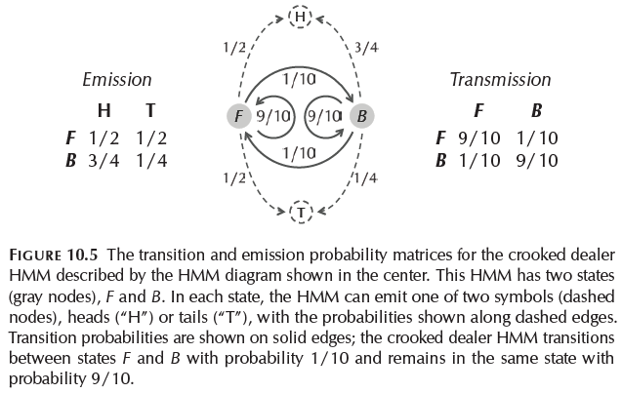

Slide 71
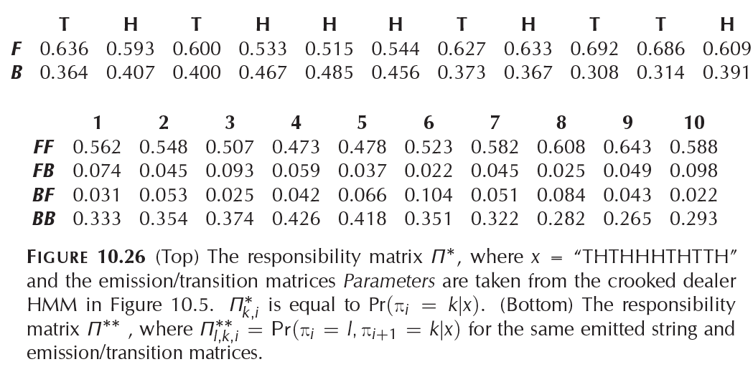

Slide 72
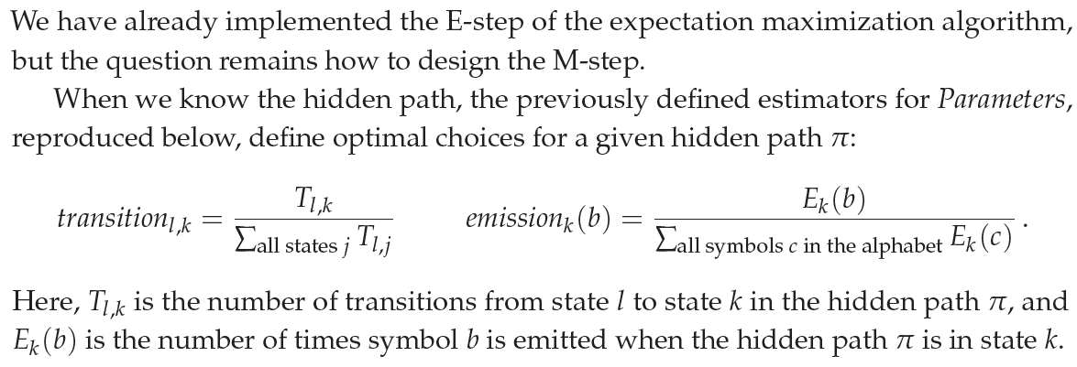
Baum-Welch Learning

Slide 73
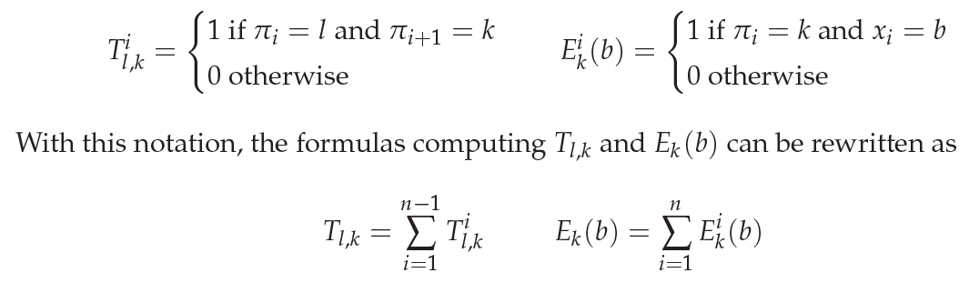
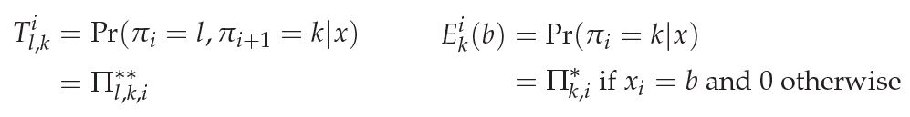
Baum-Welch Learning
When the hidden path is unknown

Slide 74
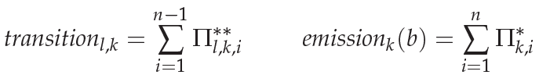
Baum-Welch Learning
When the hidden path is unknown

